Slide 1
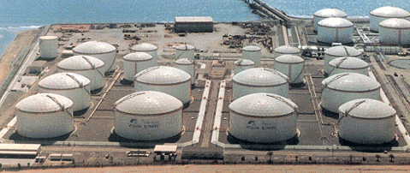

Corrologic® for ASTs

Slide 2

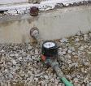


System Components
Replenishment
Monitoring
VpCI

Slide 3
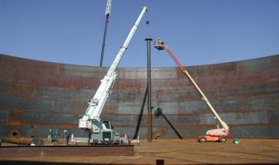
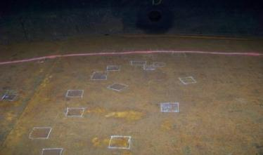
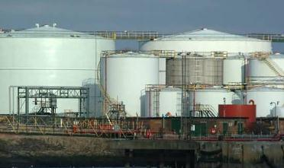
CorroLogic® is applicable for multiple scenarios
New Tanks
Out-of-Service Tanks
In-Process

Slide 4
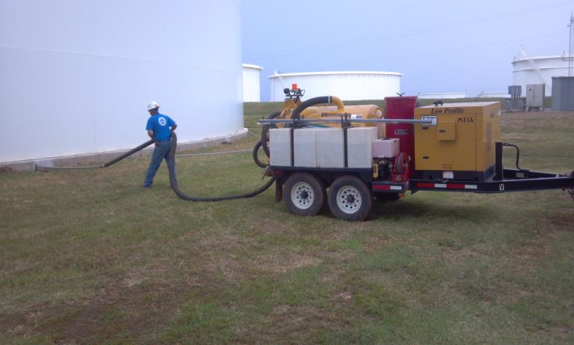
CorroLogic® for In-Service ASTs

Slide 5
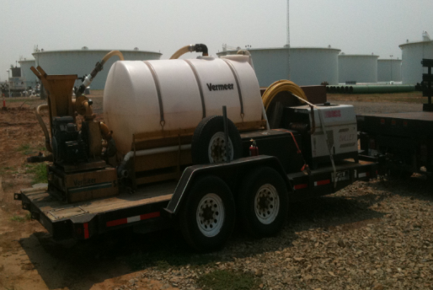
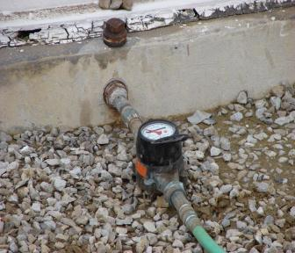
VpCI System Installation
Equipment for Mixing VpCI &
Pumping Slurry to the Tank
Metering Flow of VpCI
Slurry into Tank

Slide 6
THANK YOU!

